Slide 1
Business Education for CPEC
Lt Gen (R) Muhammad Asghar
Consultant CPEC, Higher Education Commission
Former Rector National University of Sciences & Technology (NUST)

Slide 2
Business Education for CPEC
Scope
CPEC Consortium of Business Schools/ Universities
CPEC Long Term Plan and Supportive Academic Effort
Looking East for Business Education

Slide 3
CPEC Consortium of Business Schools/ Universities

Slide 4
CPEC Consortium of Business Schools
HEC and China Association of Higher Education (CAHE) established CPEC Consortium of Business Schools on 28-29 August 2017 at Islamabad.
It comprises nine top Chinese universities and ten Pakistani universities/ Business Schools

Slide 5
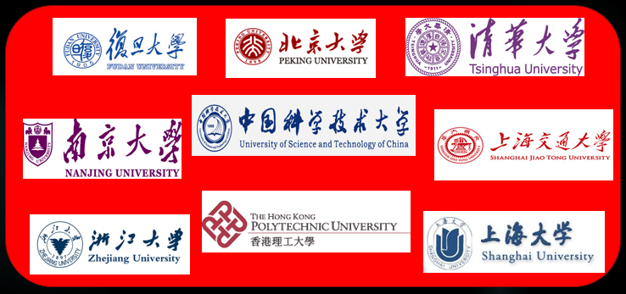
CPEC Consortium of Business Schools
Chinese Universities

Slide 6
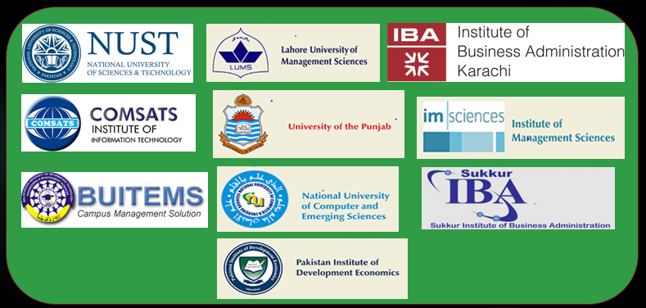
CPEC Consortium of Business Schools
Pakistani Universities

Slide 7
CPEC Consortium of Business Schools/ Universities
CPEC University Alliance was established in November 2017 at Fudan University, Shanghai.
It is planned to be expanded to include 50 universities from each country with clusters such as Agriculture, Engineering, Science and Technology, Social Sciences & Humanities, etc.
Annual conferences of the Alliance are planned to be held in China and Pakistan alternately.

Slide 8
CPEC Consortium of Business Schools/ Universities
Objectives
Promote academic linkages and collaboration between partner universities of the two countries, so as to exploit opportunities appearing as part of Belt and Road initiative.
Develop the capacity of Pakistani universities with the ‎help and collaboration of Chinese universities in selected ‎areas, while offering high-quality research candidates to ‎Chinese universities.

Slide 9
CPEC Consortium of Business Schools/ Universities
Objectives
Study Chinese model of business and economic development, and explore possibilities of creating instruments for replicating the same in Pakistan.
Support the objectives of CPEC Long Term Plan

Slide 10
CPEC Long Term Plan and Supportive Academic Effort

Slide 11
CPEC Long Term Plan
Connectivity, including infrastructure, for integrated ‎transport ‎system and establishment of digital corridor,
Energy-related infrastructure,
Trade & industrial parks,
Agriculture & poverty alleviation,
Tourism and development of ocean economy
Cooperation in areas concerning people’s livelihood & non-governmental exchanges and
Financial cooperation and border management.

Slide 12
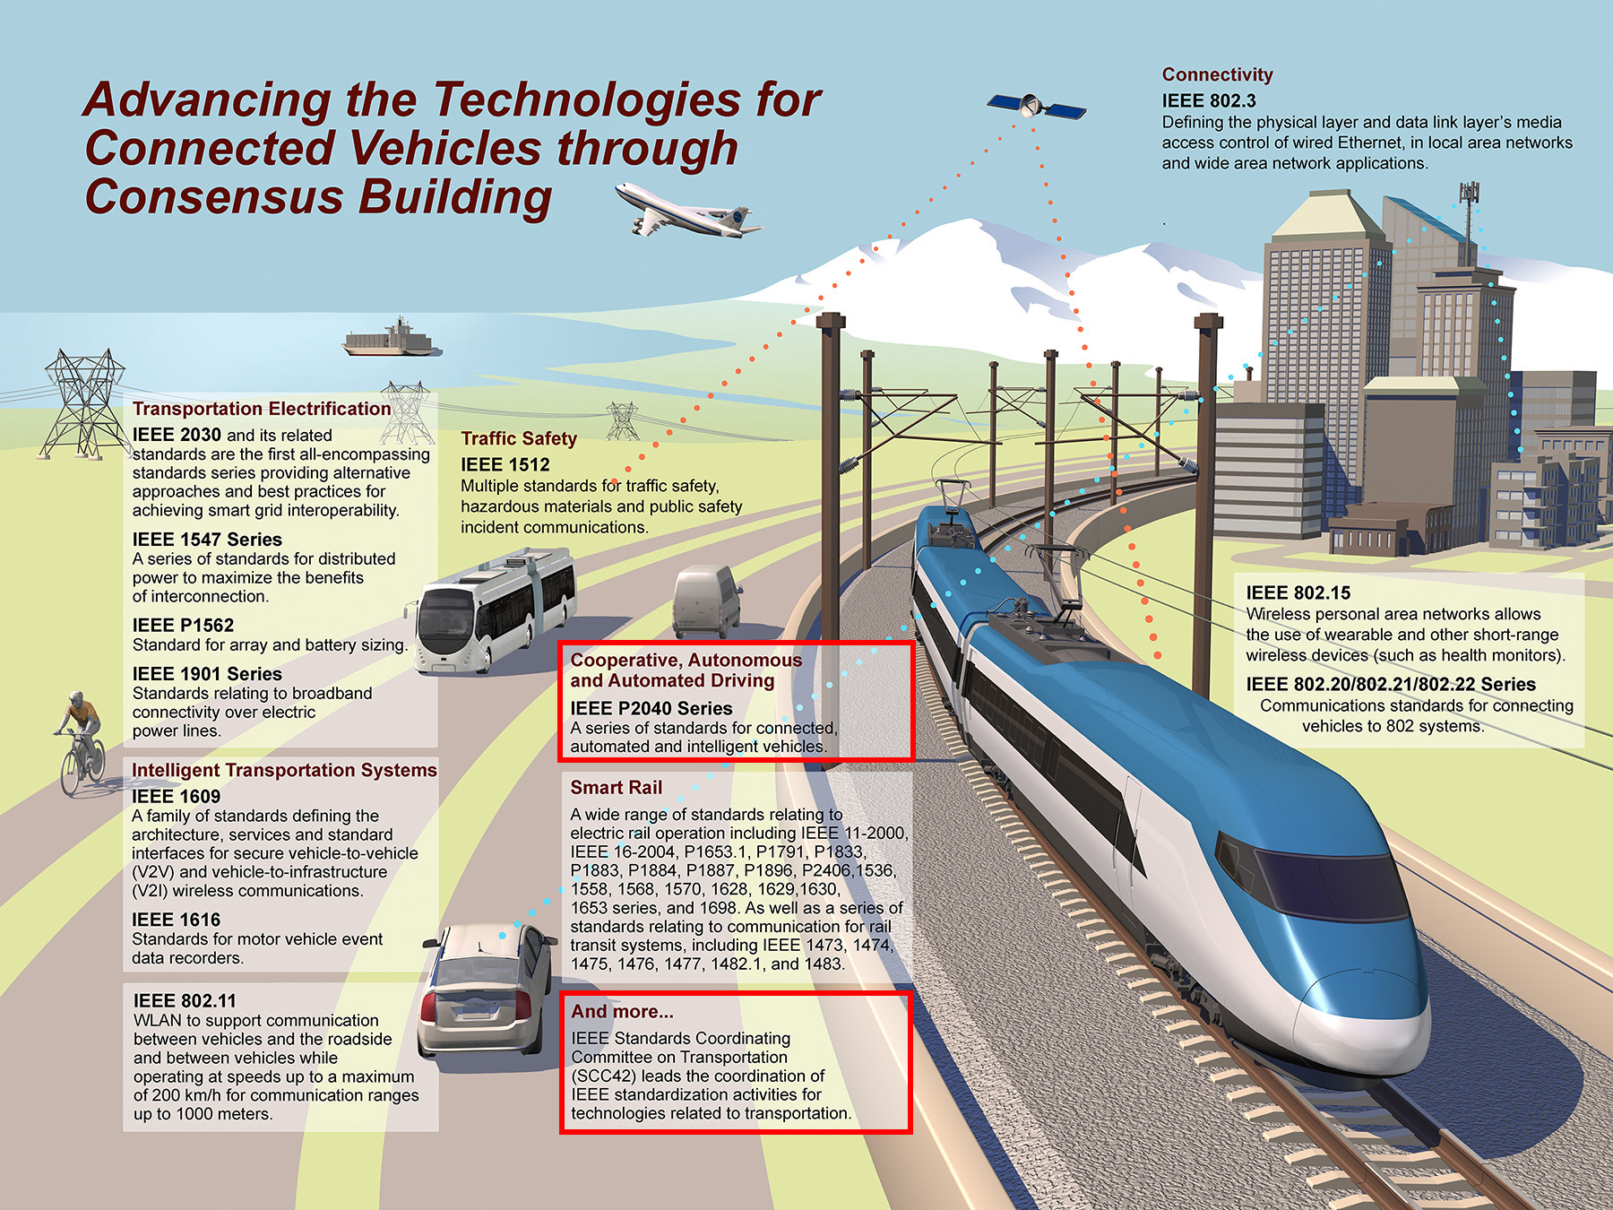
CPEC Long Term Plan and Supportive Academic Effort
“Connectivity is destiny”
─ Parag Khanna

Slide 13
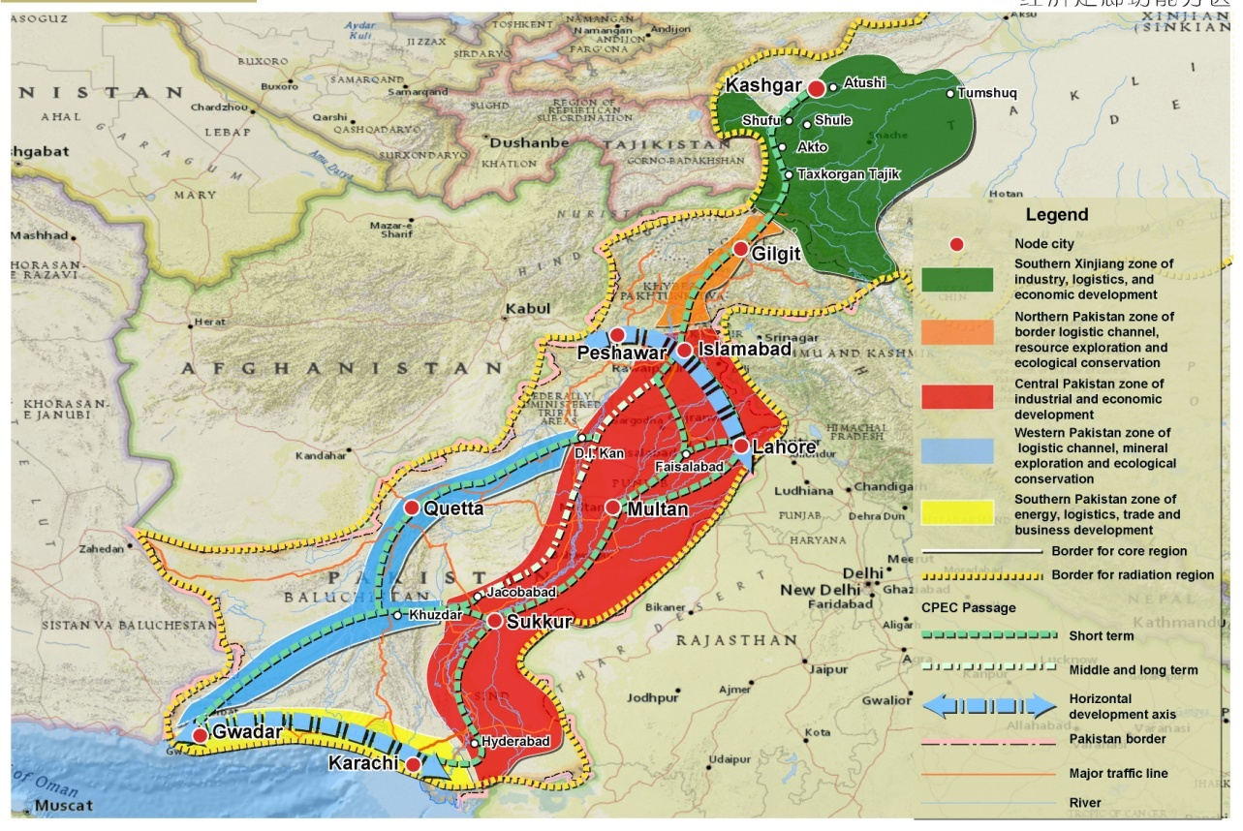
CPEC: Spatial Layout (LTP)

Slide 14
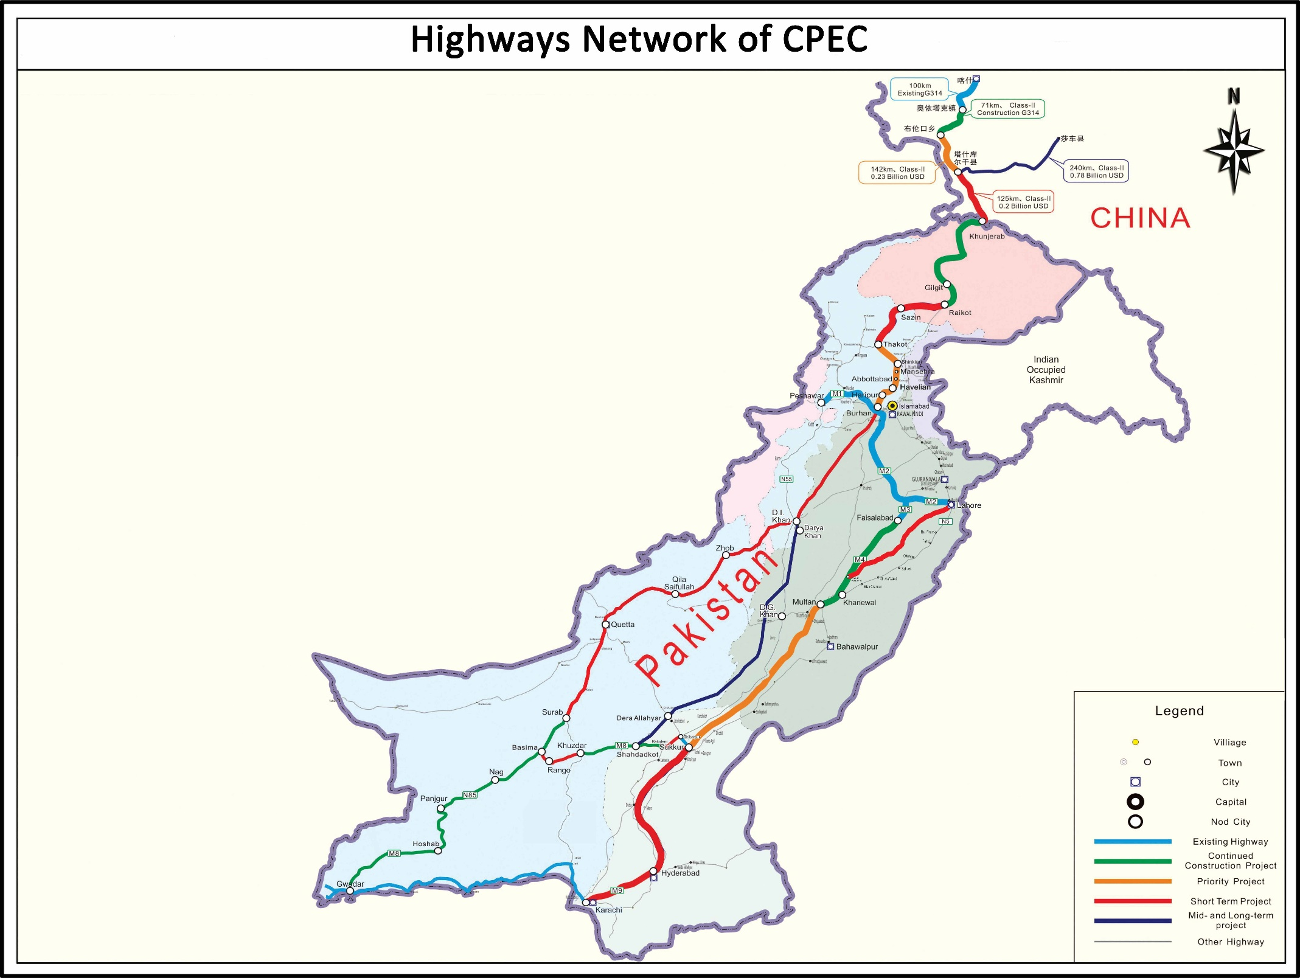

Slide 15
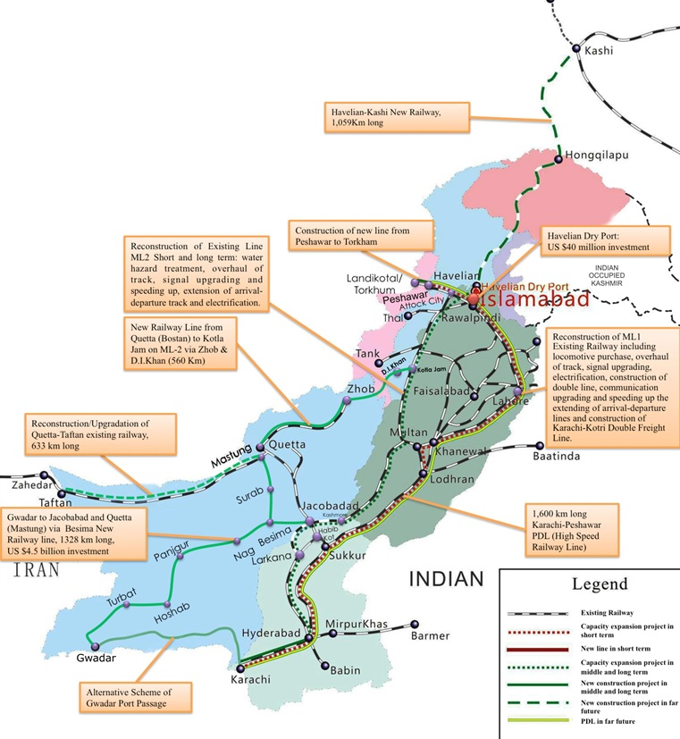
CPEC Railway Infrastructure

Slide 16
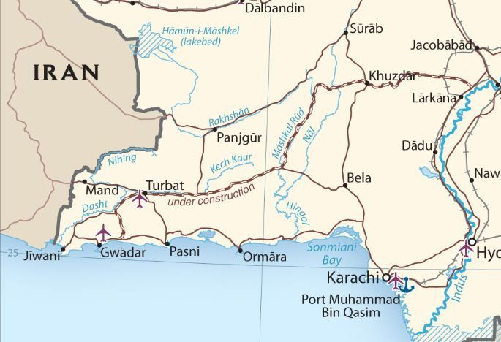
EEZ & Coastal Tourism Development
Sonmiani
4
1
2
3
2 +1 + 5
5
Keti Bandar

Slide 17
CPEC Long Term Plan and Supportive Academic Effort Connectivity Value Chain and Business Education
European companies have software development in the United States, manufacturing in Asia, back-office work in the Middle East, and joint ventures with local partners for after-sale services, and insurance in every market they sell.
Products of such hybrid value chain should carry the label: Made Everywhere (WTO Chief Economist, Patrick Low).

Slide 18
CPEC Long Term Plan and Supportive Academic Effort Connectivity Value Chain and Business Education
In such a global value chain system, even the most advanced economies cannot create good exports without good imports.
Eighty percent (80%) of world trade takes place within and among the supply chains of global multinational firms and their affiliates.

Slide 19
CPEC Long Term Plan and Supportive Academic Effort Connectivity Value Chain and Business Education
Global services trade doubles every five years, because of which commerce is increasingly conducted more on digital waves than across the ocean ones.
Services account for more than 60% of the total value of world trade and more than half the world work-force.

Slide 20
CPEC Long Term Plan and Supportive Academic Effort Connectivity Value Chain and Business Education
Technology dose not eliminate supply chains; it only morphs them.
Manufacturing will have global dimensions no matter how radical the technology is.

Slide 21
CPEC Long Term Plan and Supportive Academic Effort Connectivity Value Chain and Business Education
Logistics will remain as important as ever and connectivity will drive geo-economic and geo-political agendas like One Belt One Road.
Quest for innovation and creativity through academia will steer the course that geopolitics takes in the future and the value that a connected node carries.

Slide 22
CPEC Long Term Plan and Supportive Academic Effort Connectivity Value Chain and Business Education
Every pillar of CPEC Long Term Plan offers multiple business streams and academia must come forward to meet the challenge.
Business education must therefore look beyond their traditional boundaries.

Slide 23
Looking East for Business Education

Slide 24
Looking East for Business Education
China has a unique growth model that needs a careful study to draw lessons for ourselves.
It is not only the change but also the phenomenal rate of change that makes Chinese model of growth unique.

Slide 25
Looking East for Business Education
In addition to finance, HR and marketing management, every business school must teach supply chain management, operation and logistic management, project management and management of all kinds of new businesses related to services.

Slide 26
Looking East for Business Education
All business schools must integrate technology and entrepreneurship with business education.
In any case, innovation is just not possible without integrating technical competencies with business models.

Slide 27
Looking East for Business Education
Disruptive Innovation
Architectural Innovation
Inter-disciplinary Education is Inescapable Necessity for Innovation
Business Model
New
Incremental Innovation
Radical
Innovation
Existing
Existing
New
Technical Competencies

Slide 28
Looking East for Business Education
China has shocked the world by its productivity, work culture, values and sustained high growth.
They call their economic model as Sino-Socialism (Socialism with Chinese characteristics).
It has dramatically expanded its technical workforce (science and engineering graduates) from 359,000 to 1.65 million between 2000 and 2014.

Slide 29
Looking East for Business Education
China has successfully integrated its academia, government, industry and society, following the Quadruple Helix Model:

Slide 30
G L O B A L
Security
Security
Government
Security
Think
Tank
2
Gover-
nance
Quadruple Helix Model
for
Integrated Growth
Academia
1
National
Vision
3
Society
R E G I O N A L
Socio
Economic
Growth
Applied
R&D
4
Security
Security
Industry
Security
16

Slide 31
Follow-up Actions to Provide Academic Support to CPEC LTP
Expansion of University Alliance .
Dual degree programs with Chinese universities.
Identification of knowledge and skill gaps and launch of Faculty Development Program to cover them.
Establishment of Integrated Research Centers in selected universities.
Establishment of China-Pakistan Joint Research Centers.
Development of specialist institutes to provide depth in selected academic fields.
Establishment of Area Study Centers to promote civilizational harmony.

Slide 32
Thank You

